Slide 1
DS 501 Project 6 Gender Recognition by Voice Analysis
Group 6
Yan Zhao, Xingfa Zhuang, Ruojing He, Loc Nguyen

Slide 2

Background
Crime Detection
Hands-Free AI assistant (SIRI, Google Home, Alexa…)
Financial Information Security (Bank Account,...)

Slide 3
Dataset Description
Voice dataset from Kaggle
3000+ voice record samples
Roughly 20 Attributes/Features for each voice measurement:
Mean Frequency
Mode Frequency
Median Frequency
….
Label/ Response: Male or Female

Slide 4

Data Reprocessing
Check and get rid of Null values in columns
Check the number of two classes(Male & Female), the dataset is balanced
Change ‘Label’ as dummy variable, ‘male’ = 0 and ‘female’ = 1
Standardized all features in dataset
Split dataset as training dataset and test dataset

Slide 5
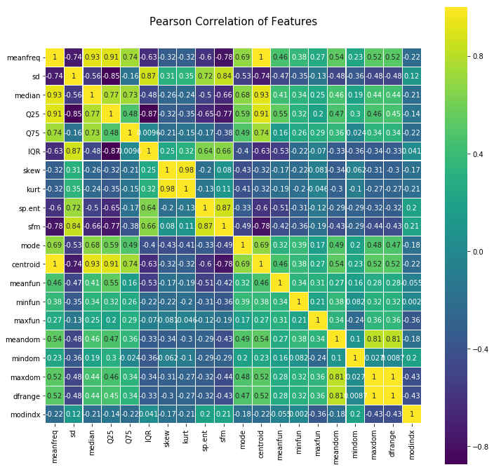
Data Reprocessing --Corrlation
Check the correlation of variables
Drop ‘centroid’ (Corr(‘centroid’, ‘meanfreq’) = 1)
Drop 'dfrange’(Corr('dfrange’, ‘maxidom’) = 1)
Drop ‘IQR’(Linearity ‘IQR’ = ‘Q75’ – ‘Q25’)

Slide 6
Methodology
K-Nearest Neighbor
Logistic Regression
Support Vector Machine

Slide 7
K-Nearest Neighbor
When we use all of the 17 features, we have the accuracy of 0.719696969697.
Modified Knn model by selecting different combination of variables
The combination of 'meanfreq','sd','median','meanfun','label’ gives the best result with accuracy of 0.9734848484848485.

Slide 8
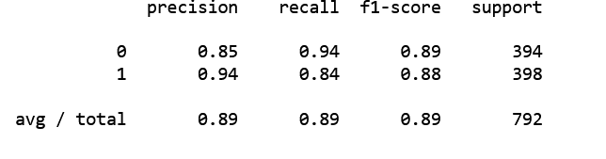
Logistic Classifier
Out[69]:
0.8888888888888888
Out[69]:
0.8888888888888888
When we use all of the 17 features, we have :
Train Accuracy :0.8930976430976431
Test Accuracy : 0.8888888888888888
Confusion Matrix
[[371, 23],
[ 65, 333]]

Slide 9
Logistic Classifier
Out[69]:
0.8888888888888888
Out[69]:
0.8888888888888888
Modified Logistic model by selecting different combination of variable
The best model has variables of : 'meanfreq','sd','median','meanfun','label’
Modified Logistic Train Accuracy : 0.8930976430976431
Modified Logistic Test Accuracy : 0.9090909090909091

Slide 10
Result and Discussion

Slide 11
Conclusion and Recommendation

